Slide 1
Registering an ALSF Lemonade Stand or Event with AmerisourceBergen

Slide 2
Step 1: Visit this link: https://www.alexslemonade.org/AB which will take you to the screen below.

Slide 3
Step 2: Scroll and Click on the Register your Fundraiser button

Slide 4
Step 3: Click Continue

Slide 5
Step 4: Enter your e-mail address

Slide 6
Step 5: Confirm e-mail address

Slide 7
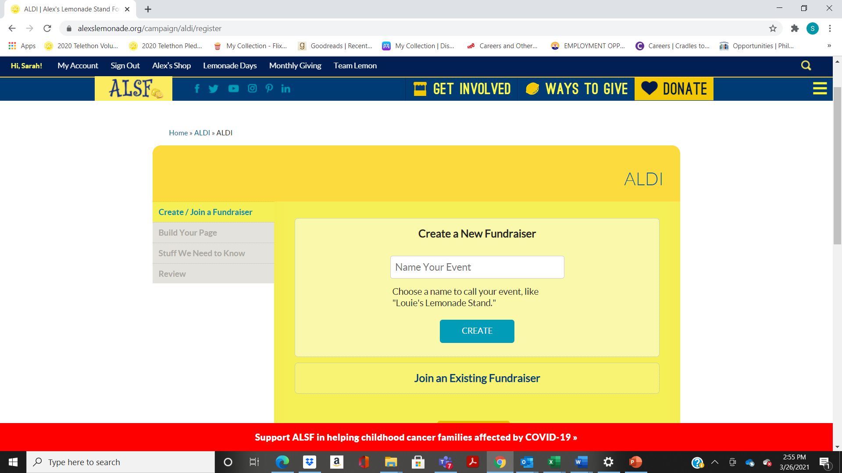
Step 6: Choose Create a New Fundraiser and name your event Click Create

Slide 8
Step 7: Choose a fundraising goal for your event *.

Slide 9
Step 8: When and Where: Fill out the information related to your event and click continue. Be sure to select your AmerisourceBergen Location at the bottom.

Slide 10
Step 9: If you are fundraising in honor or memory of someone you can indicate it on this page. If not, click no and then continue.

Slide 11
Step 10: Agree to Fundraising Agreement

Slide 12
Step 11: Confirm Your Contact Info

Slide 13
Step 12: Confirm if you would like a fundraising kit sent. You can also download items from our website to use at your stand.

Slide 14
Step 13:You can skip this by clicking continue or let us know why you are raising money for childhood cancer!

Slide 15
Step 14: Review your information and create a password for your account. This password will allow you to log in and make changes to your page.
Test AB

Slide 16
Step 15: Click Submit * If you would like to make the first donation to your page you can here, if not just click Submit

Slide 17
Step 16: Customize your Page Your fundraising page has now been created. Anything with a Yellow Cog symbol next to can be update

Slide 18
Step 17: Have Fun!
Now that your page is set up you can share it via social with friends and family to tell them about your event or to have them donate online with a credit card.
If you are looking to get items donated for your event please let ALSF know. Our contact Sarah, can send a letter of support to you. You can contact her at s.mcintosh@alexslemonade.org
As part of your stand kit you will get a return envelope you can use to send any money raised at your event. (Please DO NOT send cash in the mail). Checks can be payable to Alex’s Lemonade Stand Foundation or a credit card donation can be made online through your page.

